Slide 1
Convolutional Neuronal networks Practice part

Slide 2
1. Lab roadmap
Learning objectives of this chapter:
You know the different projects that you will carry out during the lab
Frame conditions of this project
Requires roughly 60 hours of work
You will deal with the following topics:

Slide 3
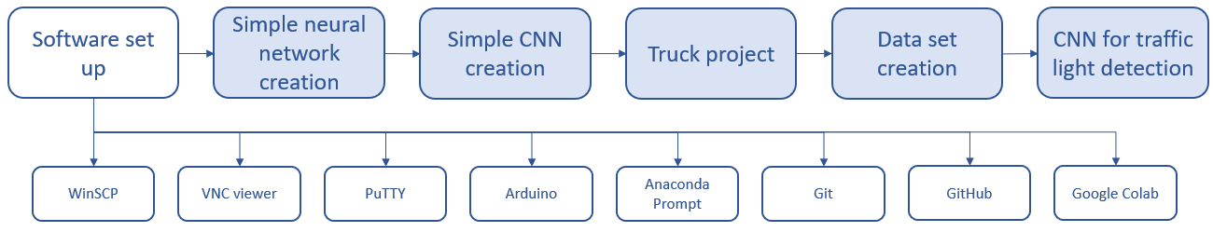
2. Software set up
Learning objectives of this chapter:
You know which programs and accounts are needed for the project
You installed and set up all important platforms
The diagram below shows which platforms are necessary

Slide 4
2. Software set up
Task: Please set up the platforms in the table below
Platform | Platform address | Account needed? | Download needed?
WinSCP | https://winscp.net/eng/download.php | No | Yes
VNC Viewer | https://www.realvnc.com/de/connect/download/viewer/ | No | Yes
PuTTY | https://www.putty.org/ | No | Yes
Arduino | https://www.arduino.cc/en/main/software | No | Yes
Anaconda prompt | https://www.anaconda.com/products/individual | No | Yes
Git | https://git-scm.com/downloads | No | Yes
GitHub | https://desktop.github.com/ | Yes | No
Google Colab | https://colab.research.google.com/notebooks/intro.ipynb | Yes | No

Slide 5
2. Software set up
Why is it necessary to install and set up some programs and accounts?
WinSCP; VNC viewer: needed to transfer data between your computer and the local computer of the truck (the Raspberry Pi)
PuTTY: is the console of WinSCP and is needed to send commands to the Raspberry Pi
Arduino: needed to make adaptions at the Arduino Nano that controls the traffic lights
Anaconda prompt: will be needed for data set creation
Git, GitHub,
Google Colab: are needed for some exercises and the truck project

Slide 6
3. Simple neural network creation
Learning objectives of this chapter:
Neural network skills:
You can set up your own neural network
You can establish your approach at the neural network creation
You can explain your neural network to others
Software skills:
You know how to save a trained network
You can set up a connection between Colab and GitHub
You can unzip files in the network

Slide 7
3. Simple neural network creation
Task:
Set up a neural network that is able to distinguish between different types of clothes
Use the fashion MNIST data set
The accuracy should be at least 90%
The data set contains 60.000 training pictures and 10.000 test pictures

Slide 8
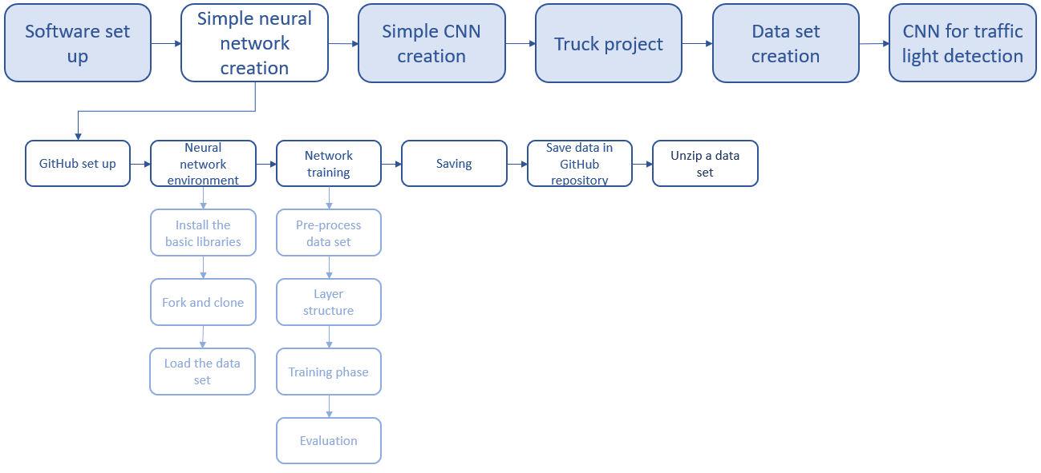
3. Simple neural network creation
For the creation of a neural network follow the described steps. A detailed description is available in chapter 3 of the script.

Slide 9


3. Simple neural network creation
3.1 GitHub set up
Create a GitHub folder structure for the repository
Then load the fashion MNIST data set into the repository
3.2 Neural network environment
environment set up includes:
installation of basic libraries
cloning and forking the repository
implementation of the data set
→The single process steps are described in the next section
[1]
[2]

Slide 10
3. Simple neural network creation
3.2.1 Installation of basic libraries
Install the basic libraries as for example TensorFlow or NumPy
Helpful additions:
!pip install --upgrade deeplearning2020
from deeplearning2020 import helpers
import gzip
!pip install h5py pyyaml
from_future_importabsolute_import, division, print_function

Slide 11
3. Simple neural network creation
3.2.2 Fork and clone the repository
Clone it in order to access it
Clone your own repository to be able to work with it
Clone other repositories to work with their codes, data, and results
Example:
# Forked repository
repo_url = 'https://github.com/MariusLandmann/SmartSystems_CNN_TrafficLightDetection'
#Clone repository
import os
%cd /content
repo_dir_path = os.path.abspath(os.path.join('.', os.path.basename(repo_url)))
!git clone {repo_url}
%cd {repo_dir_path}
print('Pull it so that we have the latest code/data')
!git pull

Slide 12
3. Simple neural network creation
3.2.3 Load the data set
Load the data set to the environment of your neural network
Do not forget to unzip compressed data
Example:
#mnist_reader
def load_mnist(path, kind='train'):
"""Load MNIST data from `path`"""
labels_path = os.path.join(path,
'%s-labels-idx1-ubyte.gz'
% kind)
images_path = os.path.join(path,
'%s-images-idx3-ubyte.gz'
% kind)
with gzip.open(labels_path, 'rb') as lbpath:
labels = np.frombuffer(lbpath.read(), dtype=np.uint8,
offset=8)
with gzip.open(images_path, 'rb') as imgpath:
images = np.frombuffer(imgpath.read(), dtype=np.uint8,
offset=16).reshape(len(labels), 784)
return images, labels
#Loading the data with Python
X_train, y_train = load_mnist('dataset_FASHION', kind='train')
X_test, y_test = load_mnist('dataset_FASHION', kind='t10k')
# X: images; y: labels
1
2

Slide 13
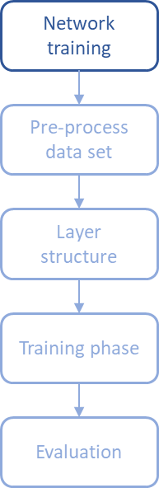
3. Simple neural network creation
Follow the described steps
Reshape, shuffle, and normalize the pixel values
Convert the labels to a vector if necessary
Create a basic layer structure for your neural network
Test different optimizers and chose the best fitting one
Train your neural network in 12 epochs
Evaluate the network with your test data set

Slide 14
3. Simple neural network creation
3.4 Save the neural network
Save it in your cloned repository
Example saving:
Recreate the network if necessary
Example recreating:
3.5 Save the data in your GitHub repository
Download the previously saved model into your locally created repository
Afterwards push it
Example for download:
model.save('./trained_CNN/fashion_MNIST/my_model_adam.h5')
#Recreate whole model
new_model=keras.models.load_model('./trained_CNN/fashion_MNIST/my_model_adam.h5')
new_model.summary()
# DOWNLOAD created files (in this case the model created previously)
from google.colab import files
files.download('./trained_CNN/fashion_MNIST/my_model_adam.h5')
# Push Anzeigen -> Inhalt -> files can display everything that download all generated

Slide 15
3. Simple neural network creation
3.6 Unzip a data set
Download the data set from the repository (https://github.com/MariusLandmann/SmartSystems_CNN_TrafficLightDetection/tree/master/dataset_FASHION/in_csv) to your local workspace
Then load it to your repository
Unzip the compressed data in Colab
Example for unzip:
# Unzip CSV data and assign a variable to it
import zipfile
with zipfile.ZipFile('/content/SmartSystems_CNN_TrafficLightDetection/dataset_FASHION/in_csv/train_compressed_fashion-mnist_train.csv.zip', 'r') as zip_ref:
zip_ref.extractall('/content/SmartSystems_CNN_TrafficLightDetection/dataset_FASHION/in_csv')
train_csv='/content/SmartSystems_CNN_TrafficLightDetection/dataset_FASHION/in_csv/fashion-mnist_train.csv'
#!cat {train_csv}

Slide 16
4. Simple CNN creation
Learning objectives of this chapter:
You can set up your own CNN
You can establish your approach at the CNN creation
You can explain your CNN to others
You can integrate a data set in Colab
You know how to save a trained network

Slide 17
4. Simple CNN creation
Task:
Set up a neural network that is able to distinguish between ten different dog breeds
Use the fashion ImageWoof data set
The accuracy should be at least 50%
At first you should download the data set from deeplearning2020 and integrate it in Colab.
Example:
!pip install --upgrade deeplearning2020
from deeplearning2020.datasets import ImageWoof
train_data, test_data, classes= ImageWoof.load_data()

Slide 18
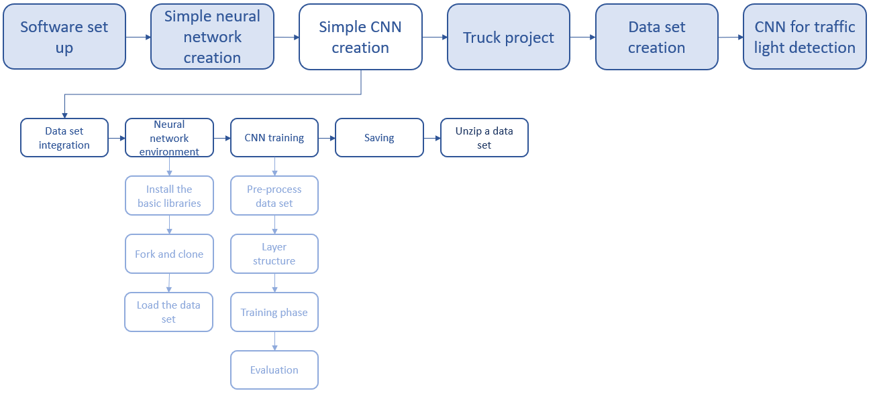
4. Simple CNN creation
Follow the described steps for the creation of a neural network. For a detailed description look into the task you have done before.

Slide 19
4. Simple CNN creation
After the CNN was created answer the following questions:
What are the main differences in the layer structure between the exercises of chapters 3 and 4?
Which CNN is faster?
Why is one CNN faster than the other?
What had the most influence on increasing the accuracy of the CNN?
Were there any surprising findings for you? If yes, which ones?
Which part was most problematic for you?

Slide 20
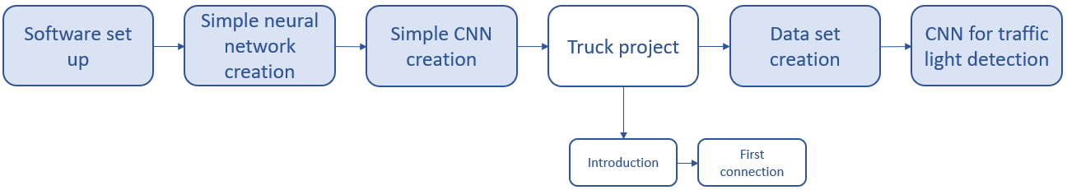
5. Truck project
Learning objectives of this chapter:
You can explain the “Smart Truck” project that will be implemented during the laboratory sessions
You know the hardware and software design of the truck
You can explain how to set up a connection between your computer and the truck (Raspberry Pi)

Slide 21
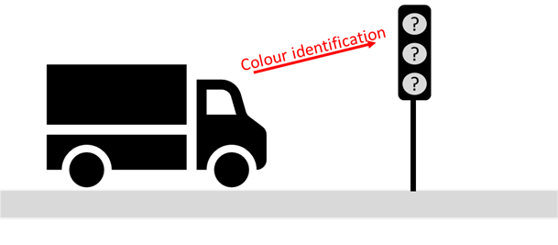
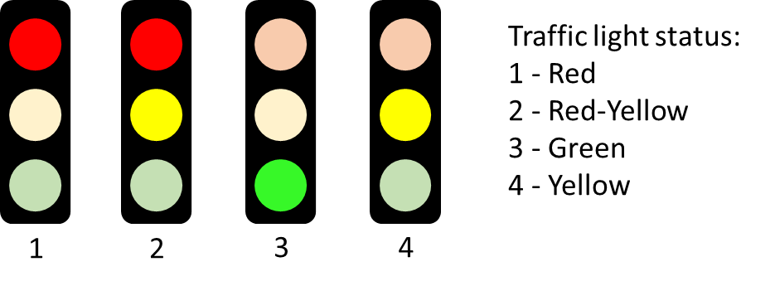
5. Truck project
5.1 Introduction to the truck project
Smart Truck CNN task
Detection of the traffic light and the correct colour.
Action according to the traffic light status (e.g. stop at red, start/continue at green)
Possible traffic light status
Task:
Please read chapters 1 till 2.2 in the “Smart Truck Manual” for more detailed instructions to the truck itself

Slide 22
5. Truck project
5.2 First truck connection
Task:
Please read the description in the “Smart Truck Manual” in chapter 3.1 and set up the connection between the Raspberry Pi and your computer

Slide 23
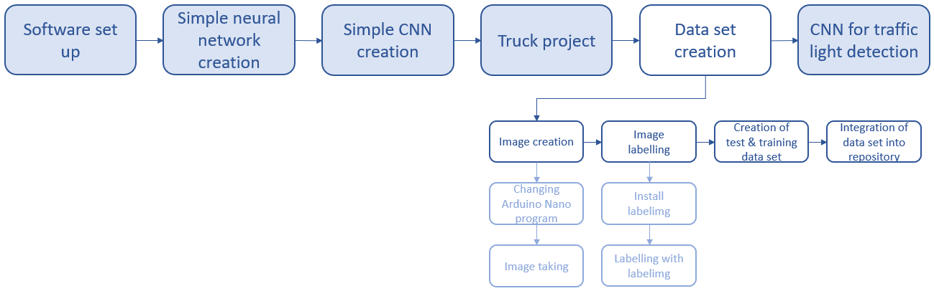
6. Data set creation
Learning objectives of this chapter:
You can explain and set up the single steps that are necessary to create a data set
You can explain and justify the requirements of a proper data set

Slide 24
6. Data set creation
Task:
Create your own data set by following the given instructions. The data set should contain 300 pictures of the traffic light that will be used in the project.
6.1 Image creation
take images of the things that should be identified
use the same device as in the truck project
use a special program for the Arduino Nano (each colour interval should have a duration of 10 seconds)
follow the Arduino Nano change instructions (6.1.2) to set the longer interval
follow the instructions for image taking (6.1.2)

Slide 25
6. Data set creation
6.1.1 Changing the Arduino Nano program
Open Arduino IDE
Configure as follows (just at the first time necessary):
Open the tab “Werkzeuge”
Chose the category “Board” and set Arduino Nano
Chose the category “Prozessor” and set ATmega328P (Old Bootoloader)
Chose the category “Port” and set COM4
Chose “Programmer” and set USBap
Now open the code “traffic_light_image” that you want to load to the Arduino Nano

Slide 26

6. Data set creation
6.1.1 Changing the Arduino Nano program
Now push the arrow in the circle to transfer the code to the Arduino Nano
Follow the same process to transfer the original program “traffic_light” back to the Arduino Nano

Slide 27
6. Data set creation
6.1.2 Image taking
Open the program “take pictures” with the VNC viewer
A picture always gets taken if you push space
Take pictures of each phase for each set up to get a balanced data set
Get a high variety of pictures:
take different picture backgrounds and image sections
→ traffic light in the middle/left/right
take pictures at different light conditions
→ light from the front/side/back and different light conditions
as daylight/twilight/night light

Slide 28
6. Data set creation
6.2 Image labelling
Tasks:
Install “labelimg” with support of the process description (6.2.1)
Label the images with “labelimg” (6.2.2)

Slide 29
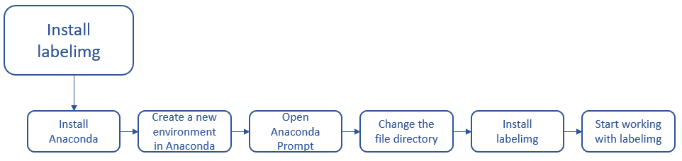
6. Data set creation
6.2.1 Install labelimg
Install “labelimg” with support of the process description in the script (6.2.1)

Slide 30
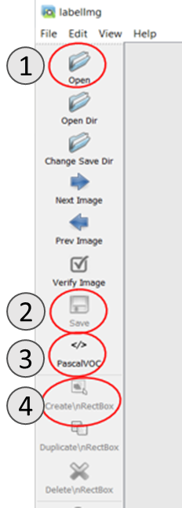
6. Data set creation
6.2.2 Label with labelimg – program overview
1 – Open a new image
2 – Save the labelled image
3 – Chose the storage format (VOC)
VOC is used if the label should be a xml file
YOLO is used if the label should be a txt file
4 – Start the labelling process

Slide 31
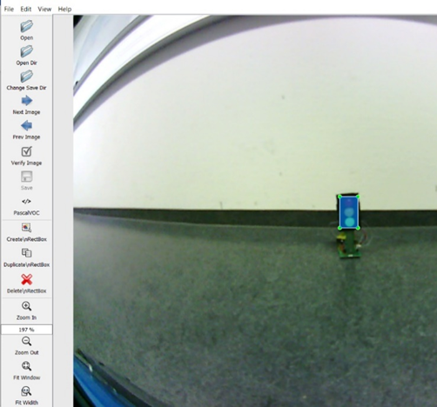
6. Data set creation
6.2.2 Label with labelimg – labeling description
Start (4) by pushing the “Create\nRectBox” button
Draw a rectangular around the traffic light that should be labelled
Set the label according the traffic light status (red traffic light, yellow traffic light, green traffic light, red-yellow traffic light)
After labelling save your image in the right format (VOC)

Slide 32
6. Data set creation
6.3 Creation of test and training data set
Split the data in two groups and save them in different folders
Training data set should be 70% of all images
Test data set should be 30% of all images
Always store the image and the related labelling file
6.4 Integration of the data set into a repository
Load both folders (test and training data set) into the project structure of your repository

Slide 33
7. CNN for traffic light detection
Learning objectives of this chapter:
You can explain the current structure of the truck CNN for traffic light detection
You know why the structure and the environment have a certain structure

Slide 34
7. CNN for traffic light detection
Explanation of the existing CNN structure
xxxx

Slide 35
References
[1] GitHub, GitHub (logo). [Online]. Available: https://​github.com​/​
[2] Google Colaboratory, Google Colaboratoy (logo). [Online]. Available: https://​colab.research.google.com​/​notebooks/​intro.ipynb

